Slide 1

Perulangan
Statement while, while bersarangan, do while
Teknik Pemprograman
Syaeful Anas Aklani, M.Kom

Slide 2
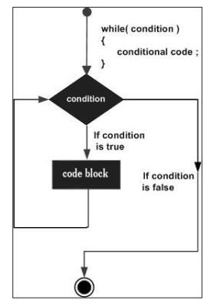
Struktur Kontrol Perulangan
A nested loop, or nested loop, is a loop that is or is located within another loop.
while The while loop statement is a statement or block of statements that is repeated until a suitable condition is reached. Form the while statement

Slide 3
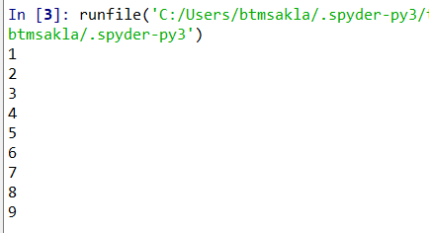
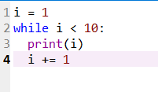
Struktur Kontrol Perulangan
while
The while loop statement is a statement or block of statements that is repeated until a suitable condition is reached. Form the while statement

Slide 4
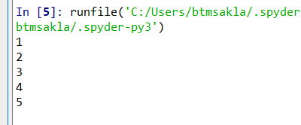
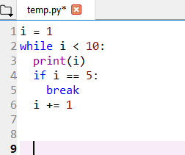
break Statement
Dengan pernyataan break kita bisa menghentikan loop bahkan jika kondisi while benar:

Slide 5
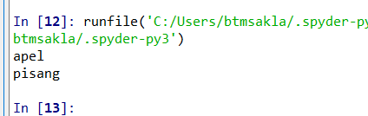
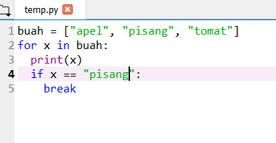
break Statement
With the break statement we can stop the loop even if the while condition is true:

Slide 6
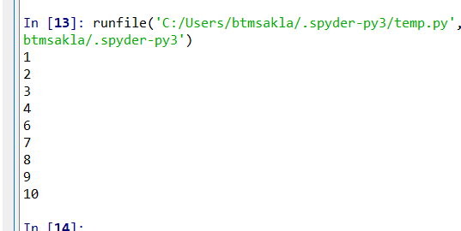
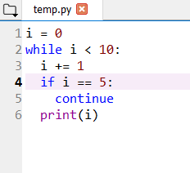
continue Statement
With the continue statement we can stop the current iteration, and continue with the next:

Slide 7
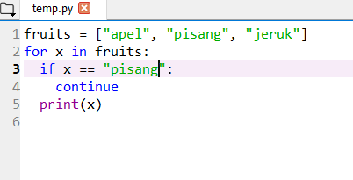
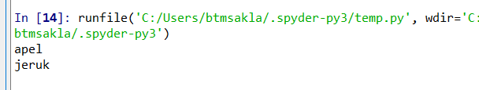
continue Statement
With the continue statement we can stop the current iteration, and continue with the next:

Slide 8
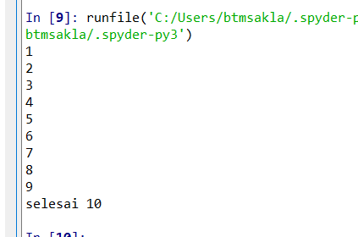
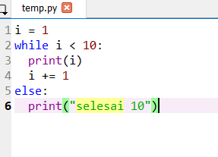
else Statement
With the else statement we can run a block of code once when the condition no longer is true:

Slide 9
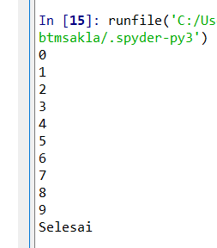
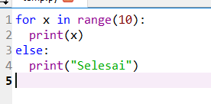
else Statement
With the else statement we can run a block of code once when the condition no longer is true:

Slide 10
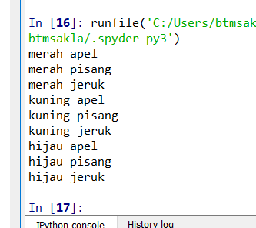
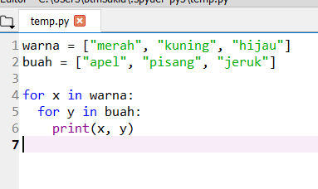
Nested Loops
A nested loop is a loop inside a loop.
The "inner loop" will be executed one time for each iteration of the "outer loop":

Slide 11
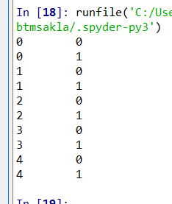
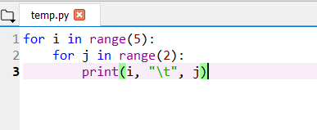
Nested Loops

Slide 12
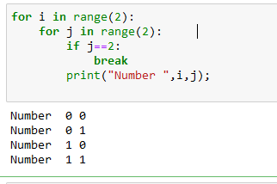
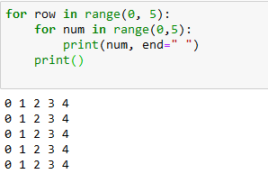
Nested Loops

Slide 13
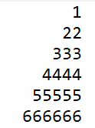
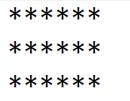
Tugas
Buat berikut ini di python : 1. 2
3. Buatlah untuk menampilkan : a) 2,3,4,6,8,12,16
b) 18,15,12,9,6,3
c) 0 ,7 ,14 ,21 ,28 ,35 ,42 ,49

